Slide 1
Animation in Python

Slide 2
Overview
Animating with computers is similar to traditional animation. The following steps outline the process taken when creating computer animation
  Clear the screen
  Draw a picture
  Pause the program a short time to allow the picture to be viewed
  Perform calculations on how to draw the next scene
  Clear the screen
  Draw a picture (similar to the previous picture but slightly different)
  …
Each new drawing only shows a tiny amount of change so the animation appears smooth.
Each shape that moves will require it to be drawn using relative coordinates

Slide 3
Example: A car driving along a road
The road can be fixed so no animation is required.
The car (and its components) require relative coordinates so it can be animated properly.
Make an approximation of the scene on paper first:
(x,y)
Box width = 30/30
Box height = 40/20
Wheel diameter = 20
(x+30,y+20)
(x+5, y+30)
(x+35, y+30)

Slide 4
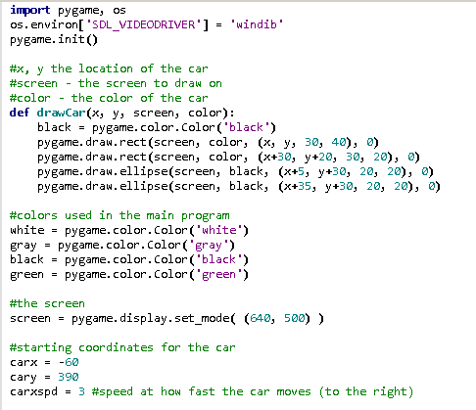
Example 1 – Moving Car

Slide 5
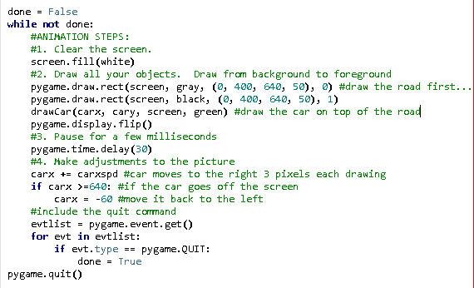
Example 1 (cont’d)

Slide 6
Delaying your program:
The line pygame.time.delay(30) delays your program for 30 milliseconds. You can adjust this to delay longer or shorter.
  Note: delays that are very small may cause your program to flicker

Slide 7
Tips for good animation
Defining functions for drawing animated parts of your program can be very useful
Each moving object should have its own speed variables in the x and y direction
  Values for the speed should be relatively small (large speed values results in “choppy” animation)
  Positive values for x and y result in the object moving to the right and down.
  Negative values for x and y result in the object moving to the left and up

Slide 8
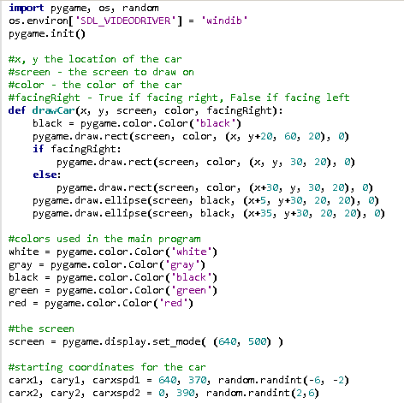
Example 2 – 2 cars!

Slide 9
